Slide 1
MODULE Seven: Asynchronous Programming
Speaker, Date
Notes:
Screenshots are all taken from PGI/PGPROF on Ubuntu 16.04
Feel free to use any profiler that you prefer.

Slide 2
Module OVERVIEW
Topics to be covered
Definition of Asynchronous Programming (and pipelining)
OpenACC Async and Wait clauses
OpenACC function routine directive
Implementing asynchronous behavior with OpenACC
Notes:
This Module was originally designed for the PGI compiler.

Slide 3
Asynchronous Programming

Slide 4
Asynchronous Programming
Programming such that two or more unrelated operations can occur independently or even at the same time without immediate synchronization.
Real World Examples:
Cooking a Meal: Boiling potatoes while preparing other parts of the dish.
Three students working on a project on George Washington, one researches his early life, another his military career, and the third his presidency.
Automobile assembly line: each station adds a different part to the car until it is finally assembled.

Slide 5
Asynchronous Example
I want to populate two arrays, A and B, with data, then add them together. This requires 3 distinct operations.
Populate A
Populate B
Add A + B
Tasks 1 and 2 are independent, but task 3 is dependent on both.

Slide 6
Asynchronous Example
SYNCHRONOUS
ASYNCHRONOUS
Populate A
Populate A
Populate B
Independent
Tasks
Populate B
Add A + B
Add A + B
In order to do tasks asynchronously, they must be completely independent from each other.

Slide 7

Asynchronous Pipelining
Very large operations may frequently be broken into smaller parts that may be performed independently.
Pipeline Stage -A single step, which is frequently limited to 1 part at a time
Photo by Roger Wollstadt, used via Creative Commons
Notes:
We will implement an asynchronous pipeline in a sample code later in the slides. This is a very common use-case of OpenACC asynchronous programming.

Slide 8
OpenaCC Async and wait Clause

Slide 9
Async clause
C/C++: #pragma acc <directive> <clauses> async(n)
Fortran: !$acc <directive> <clauses> async(n)
Async launches work asynchronously in queue n, then returns to host
In OpenACC, this allows us to run some operations concurrently
For example, we can have a device compute construct occur at the same time as host computation
Or we can perform a data transfer at the same time as a device compute construct
If n is not specified, the queues will be handled by the OpenACC runtime
#pragma acc parallel loop async
#pragma acc update device(…) async
Host Code
Notes:
If you do not provide a queue number, some default queue will be used. So if you only need one queue (good example is if you are trying to just do host/device code at the same time), leaving out the queue number is perfectly fine.

Slide 10
Async example
Default Queue
Queue 1
Queue 2
When thinking about running asynchronous operations, we can think of them as running in different “queues”
If we do not use any async in our code, we would only use a single (default) queue
We can have as many queues as we want, but initializing each queue may cause an overhead
Because of this, it is usually best to only use as many queues as you absolutely need
Notes:
A great example highlighting Bullet 3:
It is common to use two queues (queue 1 and 2), and alternate between them, as opposed to creating a new queue every time one is needed.

Slide 11
Async example
Default Queue
Queue 1
Queue 2
#pragma acc parallel loop
for( i = 0; i < 100; i++ )
X[i] = ...
#pragma acc update self(X[0:100])
#pragma acc parallel loop
for( i = 100; i < 200; i++ )
X[i] = ...
#pragma acc update self(X[100:100])
print_array(X);
Loop 1
Update 1
Loop 2
Update 2
Notes:
All of our device launches (all of our OpenACC pragma statements) are placed in a single queue. This ensures that they execute in the correct order, one after the other.
Another important thing to note is that when device work is launched in the default queue, the host code will automatically pause and wait for the device work to finish before continuing. We will see why this behavior is convenient for most codes soon.

Slide 12
Async example
Default Queue
Queue 1
Queue 2
!$acc parallel loop
do i = 1, 100
X(i) = ...
end do
!$acc update self(X[0:100])
!$acc parallel loop
do i = 101, 200
X(i) = ...
end do
!$acc update self(X[100:100])
call print_array(X)
Loop 1
Update 1
Loop 2
Update 2
Notes:
All of our device launches (all of our OpenACC pragma statements) are placed in a single queue. This ensures that they execute in the correct order, one after the other.
Another important thing to note is that when device work is launched in the default queue, the host code will automatically pause and wait for the device work to finish before continuing. We will see why this behavior is convenient for most codes soon.

Slide 13
Async example
Default Queue
Queue 1
Queue 2
Loop 1
Each operation waits for the previous to finish
This is the default OpenACC behavior
Update 1
Loop 2
Update 2
Notes:
All of our device launches (all of our OpenACC pragma statements) are placed in a single queue. This ensures that the execute in the correct order, one after the other.
Another important thing to note is that when device work is launched in the default queue, the host code will automatically pause and wait for the device work to finish before continuing. We will see why this behavior is convenient for most codes soon.

Slide 14
Async example
#pragma acc parallel loop async(1)
for( i = 0; i < 100; i++ )
X[i] = ...
#pragma acc update self(X[0:100]) async(1)
#pragma acc parallel loop async(2)
for( i = 100; i < 200; i++ )
X[i] = ...
#pragma acc update self(X[100:100]) async(2)
print_array(X);
Since these two async clauses have different numbers, they can run simultaneously
Notes:
Since the first loop and update are in the same queue, they will execute back-to-back, or one after the other. The update happen until the parallel loop finishes.
However, the loop and update in the second queue are distinctly separate from those in the first queue. This means that work in these two queues can occur simultaneously without having to wait for each other.

Slide 15
Async example
Default Queue
Queue 1
Queue 2
#pragma acc parallel loop async(1)
for( i = 0; i < 100; i++ )
X[i] = ...
#pragma acc update self(X[0:100]) async(1)
#pragma acc parallel loop async(2)
for( i = 100; i < 200; i++ )
X[i] = ...
#pragma acc update self(X[100:100]) async(2)
print_array(X);
Loop 1
Update 1
Loop 2
Update 2
Notes:
The major benefit of using async in this case is that our parallel hardware can process the first data update at the same time as the second loop. This can be quite a performance increase in some codes as it lets you “hide” some of the time needed to transfer data between host and device.

Slide 16
Async example
Default Queue
Queue 1
Queue 2
!$acc parallel loop async(1)
do i = 1, 100
X(i) = ...
end do
!$acc update self(X[0:100]) async(1)
!$acc parallel loop async(2)
do i = 101, 200
X(i) = ...
end do
!$acc update self(X[100:100]) async(2)
call print_array(X)
Loop 1
Update 1
Loop 2
Update 2
Notes:
The major benefit of using async in this case is that our parallel hardware can process the first data update at the same time as the second loop. This can be quite a performance increase in some codes as it lets you “hide” some of the time needed to transfer data between host and device.

Slide 17
Async example
Default Queue
Queue 1
Queue 2
Loop 1
By using the async clause, we allow the first update and the second loop to run simultaneously
This means that we are able to start the second loop sooner than we could without using async
There is one problem though…
Update 1
Loop 2
Update 2
Notes:
The major benefit of using async in this case is that our parallel hardware can process the first data update at the same time as the second loop. This can be quite a performance increase in some codes as it lets you “hide” some of the time needed to transfer data between host and device.

Slide 18
Async example
By using the async clause, we launch work into separate queues
Then any code afterwards continues to run
This means that the print_array function will run before we are done with our loops and updates
We can fix this with the OpenACC wait directive
#pragma acc parallel loop async(1)
for( i = 0; i < 100; i++ )
X[i] = ...
#pragma acc update self(X[0:100]) async(1)
#pragma acc parallel loop async(2)
for( i = 100; i < 200; i++ )
X[i] = ...
#pragma acc update self(X[100:100]) async(2)
print_array(X);
Notes:
As hinted at earlier, it is usually a good thing that our host code pauses and waits for all of our device work to finish.
If we do not wait for the loops and updates to finish before printing our array X, it is likely that the print will contain values we were not expecting. (Many times this means that we would see a bunch of zeroes being printed, or random memory garbage values.)

Slide 19
Async example
By using the async clause, we launch work into separate queues
Then any code afterwards continues to run
This means that the print_array function will run before we are done with our loops and updates
We can fix this with the OpenACC wait directive
!$acc parallel loop async(1)
do i = 1, 100
X(i) = ...
end do
!$acc update self(X[0:100]) async(1)
!$acc parallel loop async(2)
do i = 101, 200
X(i) = ...
end do
!$acc update self(X[100:100]) async(2)
call print_array(X)
Notes:
As hinted at earlier, it is usually a good thing that our host code pauses and waits for all of our device work to finish.
If we do not wait for the loops and updates to finish before printing our array X, it is likely that the print will contain values we were not expecting. (Many times this means that we would see a bunch of zeroes being printed, or random memory garbage values.)

Slide 20
Wait Directive
C/C++: #pragma acc wait(n)
Fortran: !$acc wait(n)
Wait blocks host until all operations in queue n have completed
The wait clause will pause your program until all previous async operations are completed
If n is not specified, then your program will pause until all queues have completed
#pragma acc parallel loop async
#pragma acc enter data copyin(…) async
#pragma acc wait
Host Code

Slide 21
Wait example
Default Queue
Queue 1
Queue 2
#pragma acc parallel loop async(1)
for( i = 0; i < 100; i++ )
X[i] = ...
#pragma acc update self(X[0:100]) async(1)
#pragma acc parallel loop async(2)
for( i = 100; i < 200; i++ )
X[i] = ...
#pragma acc update self(X[100:100]) async(2)
#pragma acc wait
print_array(X);
Loop 1
Update 1
Loop 2
Update 2
Wait
print_array(X)

Slide 22
Wait example
Default Queue
Queue 1
Queue 2
!$acc parallel loop async(1)
do i = 1, 100
X(i) = ...
end do
!$acc update self(X[0:100]) async(1)
!$acc parallel loop async(2)
do i = 101, 200
X(i) = ...
end do
!$acc update self(X[100:100]) async(2)
!$acc wait
call print_array(X)
Loop 1
Update 1
Loop 2
Update 2
Wait
print_array(X)

Slide 23
Mandelbrot Sample Code

Slide 24

SAMPLE CODE: MANDELBROT
Application generates the image to the right
Each pixel in the image can be independently calculated
Our goal is to use async to be able to pipeline some of the image generation process
You may view this code at the below github link:
https://github.com/NVIDIA-OpenACC-Course/nvidia-openacc-course-sources

Slide 25
Main loop
int main()
{
...
for(int y=0;y<HEIGHT;y++) {
for(int x=0;x<WIDTH;x++) {
image[y*WIDTH+x]=mandelbrot(x,y);
}
}
...
}

Slide 26
Main loop
...
do y = 1, HEIGHT
do x = 1, WIDTH
image(y,x) = mandelbrot(x,y);
end do
end do
...

Slide 27
Mandlebrot function
// Calculate value for a pixel
unsigned char mandelbrot(int Px, int Py) {
double x0=xmin+Px*dx; double y0=ymin+Py*dy;
double x=0.0; double y=0.0;
for(int i=0;x*x+y*y<4.0 && i<MAX_ITERS;i++) {
double xtemp=x*x-y*y+x0;
y=2*x*y+y0;
x=xtemp;
}
return (double)MAX_COLOR*i/MAX_ITERS;
}

Slide 28
Mandlebrot function
! Calculate value for a pixel
function mandelbrot(Px, Py) result(P)
integer, intent(in) :: Px, Py
integer :: P, i
real*8 :: x, y, x0, y0, xtemp
x0 = xmin+Px*dx; y0 = ymin+Py*dy
x = 0.0; y = 0.0; i = 0
do while (x*x+y*y < 4.0 and i<MAX_ITTERS)
xtemp = x*x+y*y+x0
y = 2*x*y+y0
x = xtemp
i = i + 1
end do
P = dble(MAX_COLOR)*i/MAX_ITERS
end function mandelbrot

Slide 29
Functions inside compute regions
int main()
{
...
#pragma acc parallel loop \
copy(image[0:HEIGHT*WIDTH])
for(int y=0;y<HEIGHT;y++) {
#pragma acc loop
for(int x=0;x<WIDTH;x++) {
image[y*WIDTH+x]=mandelbrot(x,y);
}
}
...
}

Slide 30
Functions inside compute regions
!$acc parallel loop copy(image(:,:))
do y = 1, HEIGHT
!$acc loop
do x = 1, WIDTH
image(y,x) = mandelbrot(x,y);
end do
end do

Slide 31
Functions inside compute regions
int main()
{
...
#pragma acc parallel loop \
copy(image[0:HEIGHT*WIDTH])
for(int y=0;y<HEIGHT;y++) {
#pragma acc loop
for(int x=0;x<WIDTH;x++) {
image[y*WIDTH+x]=mandelbrot(x,y);
}
}
...
}
We are currently unable to call the Mandelbrot function from within an OpenACC compute region
We will have to provide OpenACC with additional information about the Mandelbrot function in order to run it on our device
To accomplish this, we must use the OpenACC routine directive

Slide 32
Functions inside compute regions
We are currently unable to call the Mandelbrot function from within an OpenACC compute region
We will have to provide OpenACC with additional information about the Mandelbrot function in order to run it on our device
To accomplish this, we must use the OpenACC routine directive
!$acc parallel loop copy(image(:,:))
do y = 1, HEIGHT
!$acc loop
do x = 1, WIDTH
image(y,x) = mandelbrot(x,y)
end do
end do

Slide 33
Routine Directive
Specifies that the compiler should generate a device copy of the function/subroutine and what type of parallelism the routine contains.
Clauses:
gang/worker/vector/seq
Specifies the level of parallelism contained in the routine.
bind
Specifies an optional name for the routine, also supplied at call-site
no_host
The routine will only be used on the device
device_type
Specialize this routine for a particular device type

Slide 34
Adding routine to mandelbrot
// Calculate value for a pixel
#pragma acc routine seq
unsigned char mandelbrot(int Px, int Py) {
double x0=xmin+Px*dx; double y0=ymin+Py*dy;
double x=0.0; double y=0.0;
for(int i=0;x*x+y*y<4.0 && i<MAX_ITERS;i++) {
double xtemp=x*x-y*y+x0;
y=2*x*y+y0;
x=xtemp;
}
return (double)MAX_COLOR*i/MAX_ITERS;
}
Now when the program is compiled, an additional device version of the mandelbrot function will be generated
When we call mandelbrot from within our parallel loop now, it will use the device version instead

Slide 35
Adding routine to mandelbrot
! Calculate value for a pixel
!$acc routine seq
function mandelbrot(Px, Py)
integer, intent(in) :: Px, Py
integer :: i
real*8 :: x, y, x0, y0, xtemp
x0 = xmin+Px*dx; y0 = ymin+Py*dy
x = 0.0; y = 0.0; i = 0
do while (x*x+y*y < 4.0 and i<MAX_ITTERS)
xtemp = x*x+y*y+x0
y = 2*x*y+y0
x = xtemp
i = i + 1
end do
mandelbrot = dble(MAX_COLOR)*i/MAX_ITERS
end function mandelbrot
Now when the program is compiled, an additional device version of the mandelbrot function will be generated
When we call mandelbrot from within our parallel loop now, it will use the device version instead

Slide 36
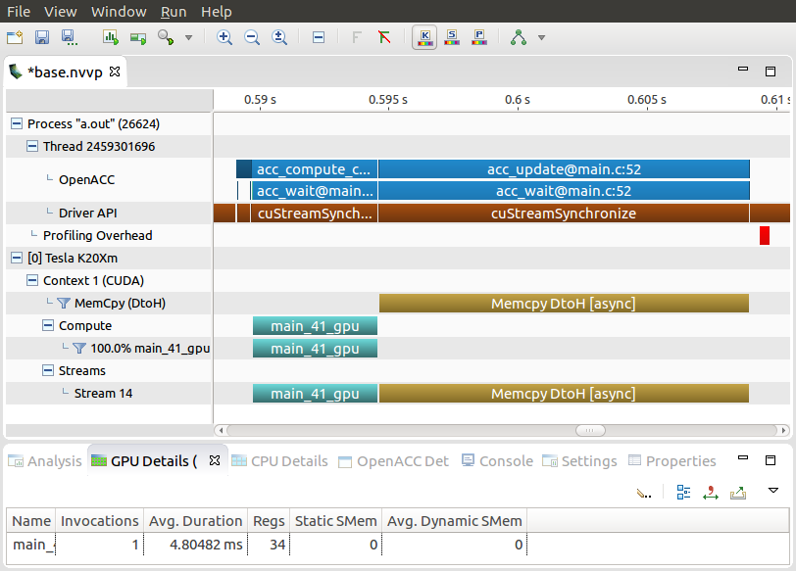
Mandelbrot Profile
Right now our data copies and compute region occur synchronously
Next we will apply the async clause to see if we could overlap some of this and see increased performance
Main Loop
Data Movement

Slide 37
Asynchronous Mandelbrot

Slide 38
Asynchronous mandelbrot
block 0
In order to get some asynchronous performance out of this code, we will break the image into multiple blocks
Then we can process each block independently
Applying the async clause to each block will then allow them to overlap
block 1
block 2
block 3

Slide 39
Asynchronous mandelbrot
int main()
{
for(int block=0; block<4; block++) {
int yStart = block*(HEIGHT/4);
int yEnd = yStart+(HEIGHT/4);
int blockSize = WIDTH*HEIGHT/4;
#pragma acc parallel loop \ copy(image[yStart*WIDTH:blockSize])
for(int y=yStart;y<yEnd;y++) {
#pragma acc loop
for(int x=0;x<WIDTH;x++) {
image[y*WIDTH+x]=mandelbrot(x,y);
}
}
}
...
}
block 0
block 1
block 2
block 3

Slide 40
Asynchronous mandelbrot
do block = 0, 3
yStart = block*(HEIGHT/4)+1
yEnd = yStart+(HEIGHT/4)+1
!$acc parallel loop &
&acc copy(image(yStart:yEnd,:))
do y = yStart, yEnd
!$acc loop
do x = 1, WIDTH
image(y,x) = mandelbrot(x,y)
end do
end do
end do
block 0
block 1
block 2
block 3

Slide 41
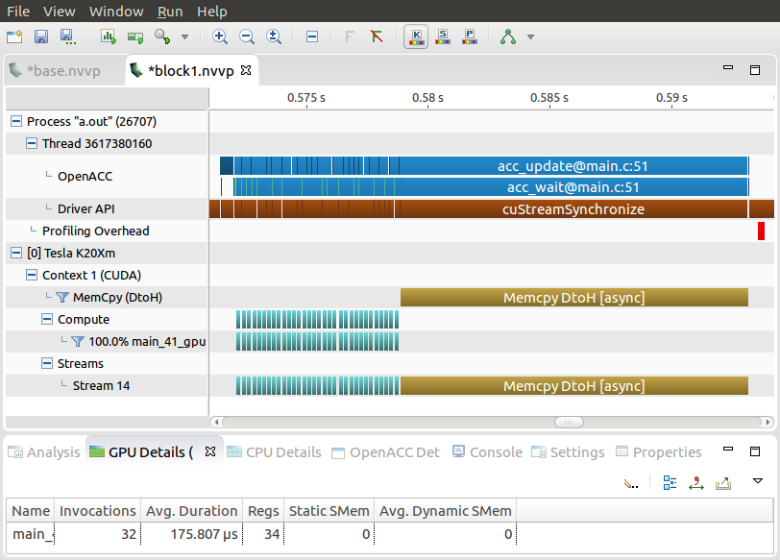
Asynchronous mandelbrot
We are computing each block separately and can see multiple kernel launches in our profile.
We also see our data transfers all happen at the end
We need to change the code to copy each block after it’s computed

Slide 42
Asynchronous mandelbrot
int main() {
int block_size = WIDTH*HEIGHT/4;
#pragma acc data create(image[0:HEIGHT*WIDTH])
for(int block=0; block<4; block++) {
int yStart = block*(HEIGHT/4);
int yEnd = yStart+(HEIGHT/4);
#pragma acc parallel loop
for(int y=yStart;y<yEnd;y++) {
#pragma acc loop
for(int x=0;x<WIDTH;x++) {
image[y*WIDTH+x]=mandelbrot(x,y);
}
}
#pragma acc update \ host(image[yStart*WIDTH:block_size])
}
}
block 0
block 1
block 2
block 3

Slide 43
Asynchronous mandelbrot
!$acc data create(image(:,:))
do block = 0, 3
yStart = block*(HEIGHT/4)+1
yEnd = yStart+(HEIGHT/4)+1
!$acc parallel loop
do y = yStart, yEnd
!$acc loop
do x = 1, WIDTH
image(y,x) = mandelbrot(x,y)
end do
end do
!$acc update self(image(yStart:yEnd,:))
end do
block 0
block 1
block 2
block 3

Slide 44
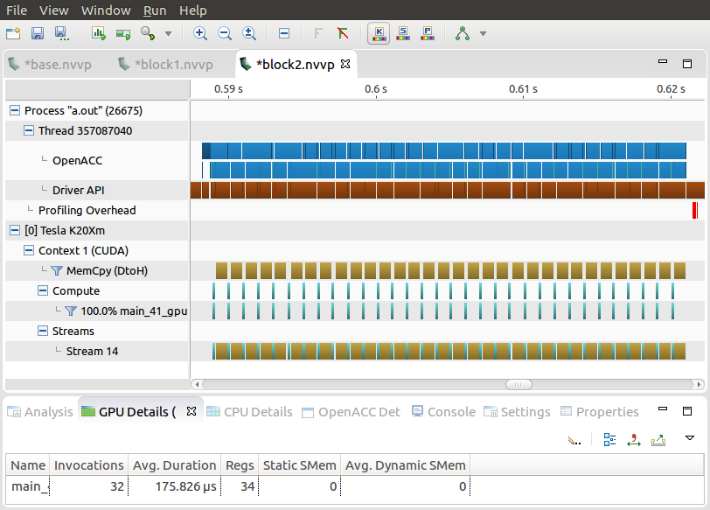
Asynchronous mandelbrot
We have moved all of the data copies to after their block
Next, we will use the async clause to overlap the data movement and compute regions

Slide 45
Mandelbrot pipeline
WITHOUT ASYNC
WITH ASYNC

Slide 46
Asynchronous mandelbrot
int main() {
int block_size = WIDTH*HEIGHT/4;
#pragma acc data create(image[0:HEIGHT*WIDTH])
for(int block=0; block<4; block++) {
int yStart = block*(HEIGHT/4);
int yEnd = yStart+(HEIGHT/4);
#pragma acc parallel loop async(block%2)
for(int y=yStart;y<yEnd;y++) {
#pragma acc loop
for(int x=0;x<WIDTH;x++) {
image[y*WIDTH+x]=mandelbrot(x,y);
}
}
#pragma acc update \ host(image[yStart*WIDTH:block_size]) async(block%2)
}
#pragma acc wait
}
block 0
block 1
block 2
block 3
Notes:
We only realistically will be able to use two queues at any given time. One queue to handle computation, and one queue to handle data movement. So in order to avoid unnecessary overhead with using a different queue for every block, we assign alternating blocks either Queue(0) or Queue(1) by doing queue(block % 2). This is a pretty standard technique for doing alternating computation/data movement codes.

Slide 47
Asynchronous mandelbrot
!$acc data create(image(:,:))
do block = 0, 3
yStart = block*(HEIGHT/4)+1
yEnd = yStart+(HEIGHT/4)+1
!$acc parallel loop mod(asyn,2)
do y = yStart, yEnd
!$acc loop
do x = 1, WIDTH
image(y,x) = mandelbrot(x,y)
end do
end do
!$acc update self(image(yStart:yEnd,:)) &
&acc async(mod(block,2))
!$acc wait
end do
block 0
block 1
block 2
block 3
Notes:
We only realistically will be able to use two queues at any given time. One queue to handle computation, and one queue to handle data movement. So in order to avoid unnecessary overhead with using a different queue for every block, we assign alternating blocks either Queue(0) or Queue(1) by doing queue(block % 2). This is a pretty standard technique for doing alternating computation/data movement codes.

Slide 48
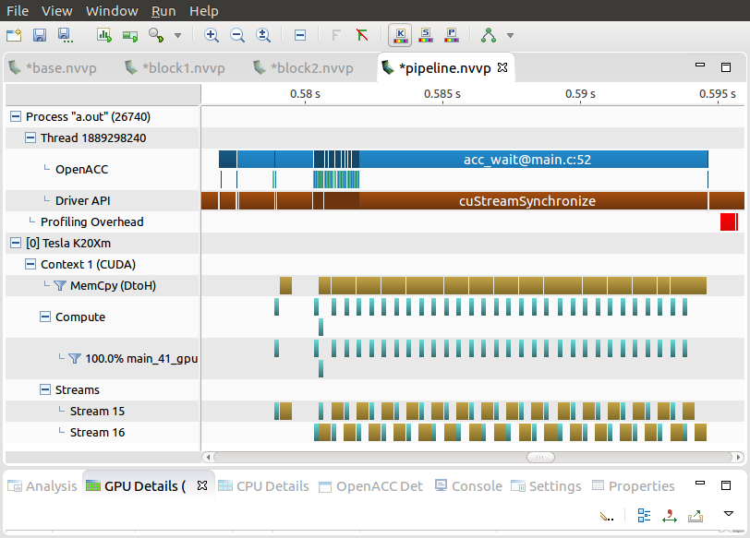
Asynchronous mandelbrot
Now in this profile, we can see that there is some overlap between the compute and data movement
Because of how the code works, some blocks take longer to run than others
We would most likely see better async performance when using more, but smaller, blocks
Notes:
The most important part of the image is the streams at the bottom. In the next slide, we will zoom in on them so they are easier to see.

Slide 49
Asynchronous mandelbrot
Zooming in, we can see two streams correlating to our two asynchronous queues
We also see the queues interleaving in-between each compute/data transfer pair

Slide 50
Other uses of async
Notes:
There is one other use of async that we feel is important to briefly touch on.

Slide 51
Other uses of async
There are two other important uses of the OpenACC async clause:
1) Execute host code and device code simultaneously
Useful when you have a lot of device computation to do, and have some host code that does not need to wait for the device to finish
2) Launch multiple device kernels into a single queue to hide launch overhead
Useful when you need to launch many kernels back to back, and no host code has to happen between them
Able to “hide” some of the launch overhead by launching kernels in the queue ahead of time

Slide 52

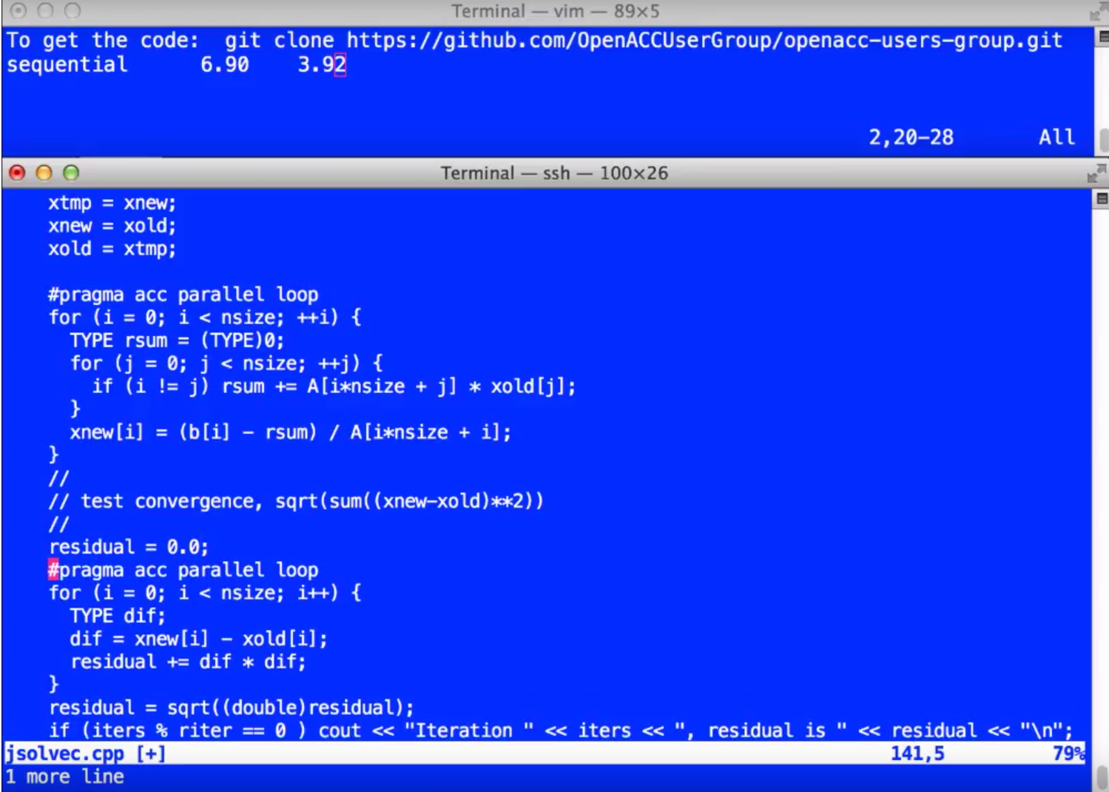
Other uses of async – Launch Overhead
For more information on using async to hide kernel launch overhead, see the YouTube video series below
https://www.youtube.com/watch?v=voOcd1bNHIA

Slide 53
Wrap-up
Asynchronous programming is a way to allow two independent operations to occur concurrently
You can accomplish asynchronous programming in OpenACC by using a pipeline method with the async clause and wait directive
Additionally, to use function calls within a device compute region, you must add the routine directive to compile a device variation of the function

Slide 54
Thank you

